Slide 1

STABILIZATION OF BLACK COTTON SOIL USING LIME AND QUARRY DUST AS A ADMIXTURES
RESERACH GROUP-GEOTECHINICAL ENGINEERING
BATCH ID:15IEGTE03
UNDER THE GUIDANCE OF
Mr. K. SHYAM CHAMBERLIN
Assistant Professor
DEPARTMENT OF CIVIL ENGINEERING
K L EF Deemed to be University
PRESENTED BY:
K .DEVANAND - 160020059
M. SAI NANDAN - 160020067

Slide 2
CONTENTS
ABSTARCT
OBJECTIVES
INTRODUCTION
METHODOLOGY
EXPERIMENTS
RESULTS AND DISCUSSIONS
CONCLUSION

Slide 3
ABSTRACT
With the increasing of population and the reduction of available land, more and more construction of buildings and other civil engineering structures have to be carried out on weak or soft soil . In this project we are going to describe about the effect of lime and some Geo-technical properties of expansive soil stabilized with the optimum percentage of Quarry dust. Black cotton soil is one of the major soil deposits of India. These soils are very expansive in nature, these expand highly when comes contact with the water .This study is carried out with an intention to evaluate the effects of Quarry dust and lime on the geotechnical properties of the locally available expansive soil from Vaddeswaram. Tests which are to be carried out on the sample of soil dealt with specific gravity, compaction, California bearing ratio, unconfined compressive strength and shear strength. These tests are to be conducted at both non-stabilized and stabilized states by adding 2%, 4%, 6%, 8% and 10% of lime in addition with 5%, 10%, 15%, 20% and 25% of quarry dust. The results show the effect of quarry dust and lime on geotechnical properties of the soil samples strength. Also it may be estimated that this is an efficient way of reducing costs, without losing the strength gains and water sensibility

Slide 4
INTRODUCTION
Black cotton soil are found in many parts of the India. Black cotton soil are found in many parts of the India. t is highly expansive in nature due to presence of clay minerals and It expands greatly when comes in contact with water and contracts when the water squeezes out. Due to this swell and shrink behaviour of black cotton soil severe damages cause to foundations of the buildings and structures constructed on them. It has been observed that the addition of Lime and Quarry dust did not changed the plasticity characteristics. Different proportions of lime and quarry dust are used to determine the basic Geo-technical properties suchas Specific gravity, compaction, unconfined compression strength, and maximum dry density.

Slide 5
OBJECTIVES
To improve the engineering properties of black cotton soils by adding lime and quarry dust.
To improve the swelling and shrinkage characteristics.

Slide 6
LITERATURE REVIEW
S. NO | AUTHOR OF THE JOURNAL | JOURNAL ANME | JOURNAL TITLE | YEAR OF PUBLICATION
1 | H.Venkateswarlu & A.C.S.V Prasad | International Journal of Industrial Engineering and Technology | Study on Behavior of Expansive Soil Treated With Quarry Dust | Volume 4, Issue 10, April 2015
2 | Dr. Akshaya Kumar Sabat | International Journal of Emerging trends in Engineering and Development | A Study on Some Geotechnical Properties of Lime Stabilised Expansive Soil –Quarry Dust Mixes | Issue 2, Vol.1( January-2012)

Slide 7
S. NO | AUTHOR OF THE JOURNAL | JOURNAL ANME | JOURNAL TITLE | YEAR OF PUBLICATION
3 | B.JAYA PRAKASH REDDY | International Journal of Pure and Applied Mathematic | STABILIZATION OF BC SOIL USING QUARRY DUST | 2018
4 | H.Venkateswarlu1, Dr DSV Prasad2, Dr.GVR Prasada Raju3 | IOSR Journal of Mechanical and Civil Engineering (IOSR-JMCE) | Study on Geotechnical Properties of Stabilized Expansive SoilQuarry Dust Mixes | 2015

Slide 8
METHODOLOGY
BLACK COTTON SOIL :
Up to now we done some experiments on black cotton soil which is highly expansive in nature. These soils are not utilized for the construction purpose in the civil engineering so, we have to do some research on these soils to use these expansive soils for construction purpose. For stabilization of this soils we added some admixtures like lime powder and quarry dust.
LIME :
Lime is one of the basic building material used mainly as lime mortar in construction.
QUARRY DUST :
It removes environmental problems as well as also contribute to the economy. Quarry dust is having higher shear strength then other wastes, which is highly beneficial for its use as a soil stabilizer.

Slide 9
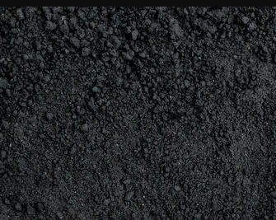
BLACK COTTON SOIL
FIGURE 1

Slide 10
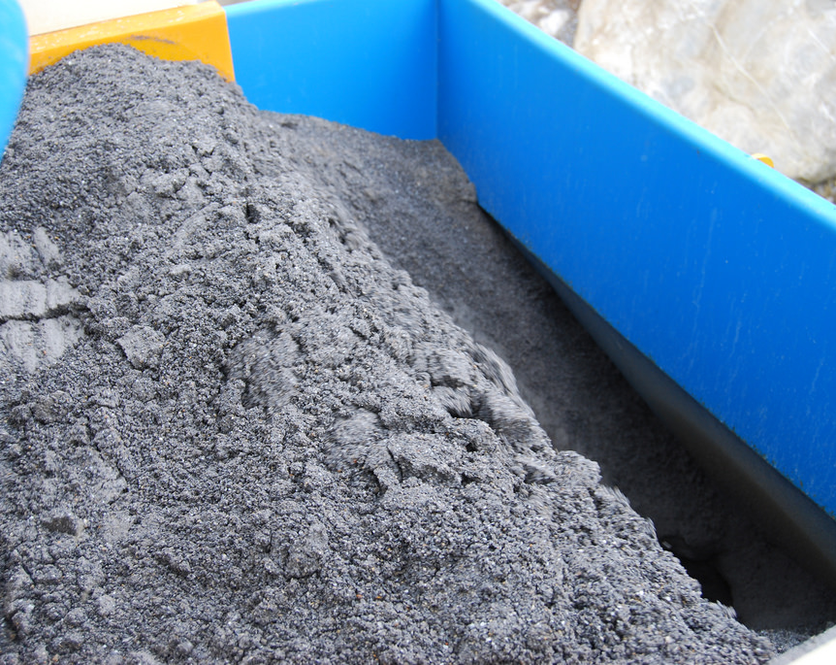
QUARRY DUST
FIGURE 2

Slide 11
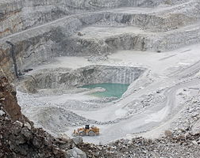
LIME MIXTURE POWDER
FIGURE 3

Slide 12
METHODOLOGY :
.
COMPARISON OF RESULTS
LITERATURE REVIEW
ENGINEERING PROEPRTIES AFFTER ADDING AD-MIXTURES
COLLECTION OF MATERIALS
PHYSICAL PROPERTIES
ENGINEERING PROPERTIES
OVERVIEW METHODS
BEHAVOIR IN DIFFERENT CONDITIONS

Slide 13
PHYSICAL PROPERTIES:
SPECIFIC GRAVITY
FREE SWELL INDEX
LIQUID LIMIT
PLASTIC LIMIT
SIEVE ANALYSIS

Slide 14
ENGINEERING PROPERTIES:
UNCONFINED COMPRESSIVE STRENGTH
STANDARD PROCTOR
MAXIMUM DRY DENSITY
OPTIMUM MOISTURE CONTENT
COHESION
SWELLING CHARECTERISTICS

Slide 15
FREE SWELL INDEX
Take the two samples of black cotton soil of 10gm of each which is sieved on 425 micron sieve.
Pour the samples separately in two different measuring jar one is with water and another one is filled with kerosene.
Keep the two measuring jars in the laboratory for 24 hours with out any disturbance.
Note down the initial readings before placing in the laboratory.
After the completion of one day the soil placed in the water is little bit raised by absorbing the water.
There is no change in the soil placed in the kerosene.
Later note down the both initial and final values in both the measuring jars.

Slide 16
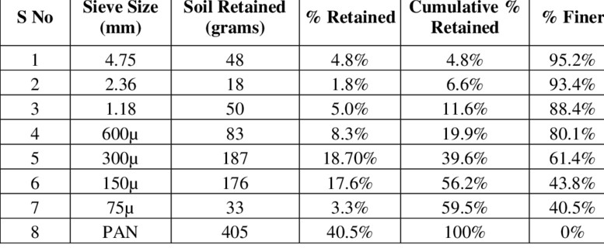
SIEVE ANALYSIS

Slide 17
RESULTS TABLE:
NAME OF EXPERIMENT | RESULTS
SIEVE ANALYSIS | 40.70%
MOISTURE CONTENT | 19.68 %
LIQUID LIMIT PLASTIC LIMIT | 45% 22.6 %
SPECIFIC GRAVITY | 2.67
WATER CONTENT BY OVEN DRY METHOD | 27.2%

Slide 18
RESULTS TABLE OF ENGINEERING PROPERTIES:
NAME OF THE EXPERIMENT | RESULTS
UNCONFINED COMPRESSIVE STRENGTH | 131 KN/M²
STANDARD PROCTOR TEST MDD OMC | 23.23 g/cc 13.5%
SWELLING CHARECTERISTICS | 86%
COHESION | 64.2 kN/m²

Slide 19
STANDARD PROCTOR :
Take a soil sample of 5kg in a tray and make sample into pieces with the help of hammer
Sieve the crushed soil passing through 425 µ sieve
Collect the 5kg soil sample and take the empty weight of the mould
Add the 5% of water to the soil sample and mix thoroughly in a pan and place the soil in a mould in three layers each layer should be tamped 25 times with tamping road
The excess compacted soil that is overfilled in the mould should be leveled equally using knife. So the mould should be exactly filled.
Take the weight of the mould and note down the value.
Remove the soil from the mould and take the soil sample and keep it in oven to know the water content.
Take the same sample and add 5% water and mix it thoroughly and continue the above process which was performed.
Until the weight reduces over previous one, experiment should be performed until the result comes.

Slide 20
STANDARD PROCTOR TABLE :
S.NO | WATER CONTENT (ML) | MASS OF MOULD (kg) | WEIGHT OF SOIL (kg) | VACANT CAN WEIGHT (kg) | MASS OF WET SOIL (kg) | MASS OF DRY SOIL (kg) | WATER CONTENT (%) | DRY DENSITY (g/cc)
1 | 120 | 2.045 | 3.75 | 0.054 | 0.095 | 0.092 | 7.8 | 1.58
2 | 140 | 2.045 | 3.867 | 0.021 | 0.055 | 0.052 | 9.6 | 1.60
3 | 160 | 2.045 | 4.021 | 0.022 | 0.054 | 0.051 | 10.3 | 1.67
4 | 180 | 2.045 | 4.056 | 0.022 | 0.068 | 0.061 | 17.9 | 1.58

Slide 21
GRAPH OF STANDARD PROCTOR:

Slide 22
UNCONFINED COMPRESSIVE STRENGTH :
S.NO | VERTICAL DIAL GAUGE | STRAIN (E) % | COMPACTED AREA | PROVING RING | LOAD PRRXPRCX5 | UNCONFINE COMPRESSIVE STRENGTH | UNDRAINED SHEAR STRENGTH
1 | 50 | 0.5 | 9.669 | 3.6 | 4.104 | 0.424 | 0.212
2 | 100 | 1 | 9.718 | 5 | 5.7 | 0.286 | 0.2.93
3 | 150 | 1.5 | 9.76 | 8 | 9.12 | 0.934 | 0.467
4 | 200 | 2 | 9.81 | 8.2 | 9.348 | 0.962 | 0.476
5 | 250 | 2.5 | 9.36 | 8.2 | 10.46 | 9.948 | 0.474
6 | 300 | 3 | 9.91 | 9.1 | 11.62 | 1.046 | 0.532
7 | 350 | 3.5 | 9.96 | 10.2 | 12.54 | 1.16 | 0.58
8 | 400 | 4 | 10.02 | 11 | 12.54 | 1.24 | 0.62
9 | 450 | 4.5 | 10.07 | 11 | 12.54 | 1.245 | 0.62
10 | 500 | 5 | 10.12 | 11 | 12.54 | 1.25 | 0.625
11 | 550 | 5.5 | 10.18 | 11 | 12.54 | 1.233 | 0.616
12 | 600 | 6 | 10.23 | 11 | 12.54 | 1.22 | 0.613

Slide 23
GRAPH OF UNCONFINED COMPRESSIVE STRENGTH :

Slide 24
CONCLUSION:
Black cotton soils when blended with quarry dust and lime are very promisinG to improve the geotechnical properties. This will provide solution for the use of locally available black cotton soil.
Specific gravity of BC soil decreased with the addition of quarry dust and lime, this reduction of specific gravity value may be due to the reduction of plasticity character of BC soil.
Maximum dry density (MDD) is observed at soil for addition of quarry dust and lime. Further addition of it, MDD value decreased.
The strength of black cotton soil increasing with the addition up to soil and further decreased.
From the test it is concluded that the strength characteristics of BC soil are optimum at (8% lime + 20% quarry dust) .

Slide 25
REFERENCES:
1.Mishra B. A study on engineering behavior of black cotton soil and its stabilization by use of lime. International Journal of Science and Research. 2015 Nov; 4(11): 1–5.
2.Tiwari A, Mahiyar H K. Experimental study on stabilization of black cotton soil by fly ash, coconut coir fiber and crushed glass. International Journal of Engineering Technology and Advanced Engineering. 2015 Nov; 4(11): 1–4.
3. Ghosh P. Fibre Science and Technology. First Edition. Tata McGraw Hill Publishing Company: New Delhi; 2004.
4. Olufowobi J, Ogundoju A, Michael B, Adrinlewo O. Clay soil stabilization using powdered glass. Journal of Engineering Science and Technology. 2014 Oct; 9(05): 541–58.
5. Suresh K, Padmavathi V, Sultana A. Experimental study on stabilization of black cotton soil with stone dust and fibers. Proceedings of 48th Indian Geotechnical Conference; India; 2009. p. 1–5.

Slide 26
6.Gourly, C.S., Newill, D., and Shreiner, H.D., “Expansive soils: TRL’s research strategy.” Proc., Int. symp. On Engineering Characteristics of Arid soils, 1993.
7.Chapman, H.D., “Cation Exchange Capacity in Methods of soil analysis”, American society of Soil Agronomy, 1965, C.A. Black et al., Eds., Madison, WI, pp.891-901.
8.N K Bhasin, N K Goswami, P Oli, N Krishnan and N B Lal (1988), “A Laboratory Study on Utilization of Waste Materials for the Construction of Roads in Black Cotton Soil Areas”, Highway research bulletin, No. 36,pp. 1-11.

Slide 27
THANK YOU

